Slide 1



MICROSOFT EXCEL
SUPERSTORE
SALES ANALYSIS
By Yandi Adi Saputra

Slide 2

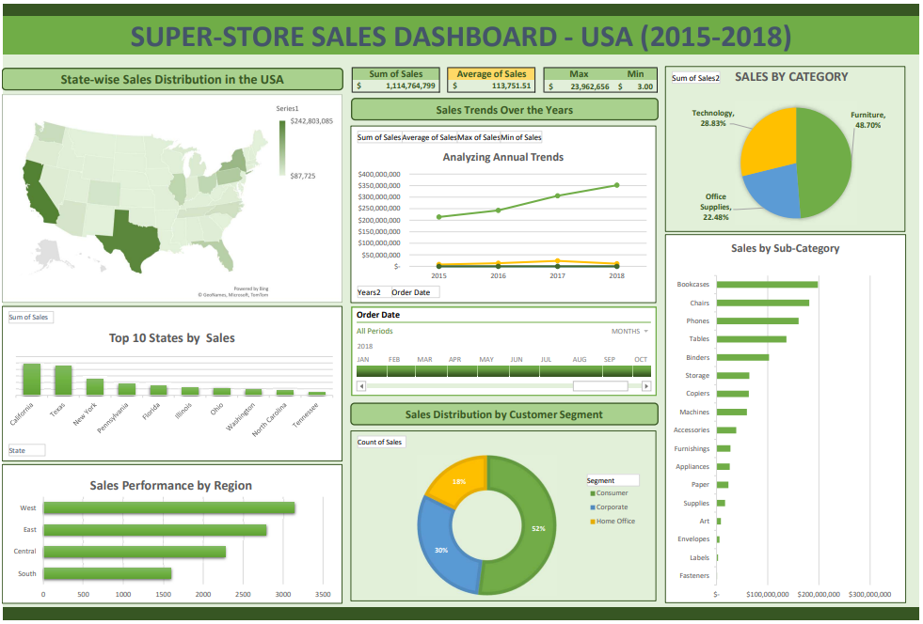
https://github.com/Yandias1/Excel-Analysis/blob/main/~%24SUPERSTORE%20SALES%20ANALYSIS.xlxs

Slide 3


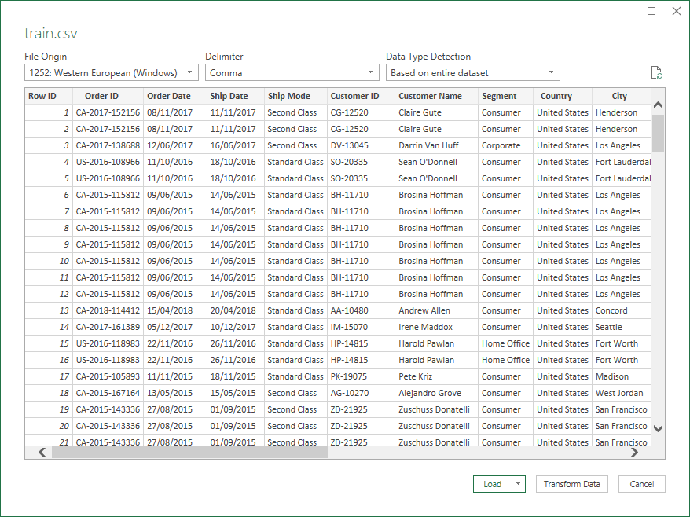
https://www.kaggle.com/datasets/rohitsahoo/sales-forecasting
ABOUT DATASET
Context
This dataset contains 4 years of sales data from a global superstore, designed for analysis using Pivot Tables and dashboard creation in Excel.
Content
The dataset can be used to analyze sales trends by time, region, or segmen. Identify top performing product by category
Purpose
To visualize data through interactive dashboards without prediction, focusing on sales patterns and performance.

Slide 4

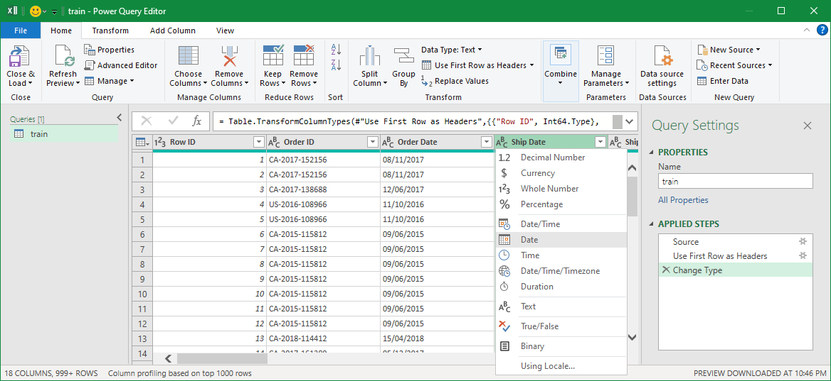
TRANSFORM DATA
Identifying Initial Data Format
The “Order Date” and “Ship Date” columns were in general text format.
Convert to Date Format
Convert the columns to a proper Date format to enable time based analysis.
All dates in the dataset are in the format MM/DD/YYYY (e.g., 08/11/2017 represent August 11, 2017).
Close and Load Data
After transforming the date
format, close the query editor and load the cleaned dataset.

Slide 5
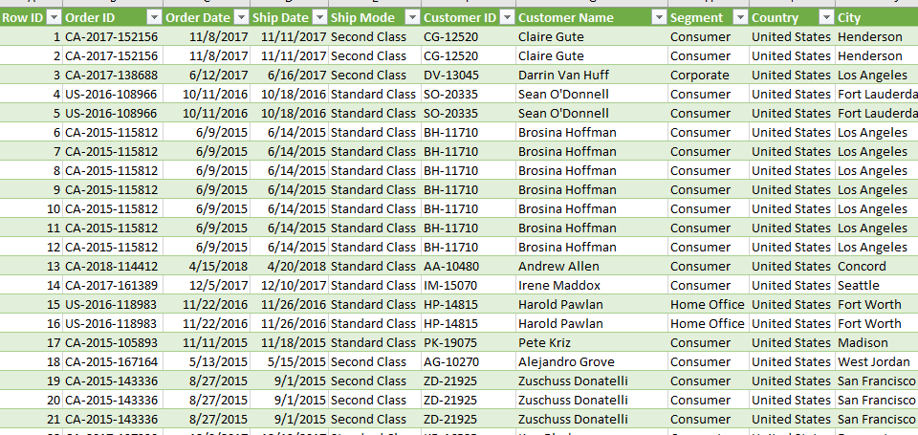
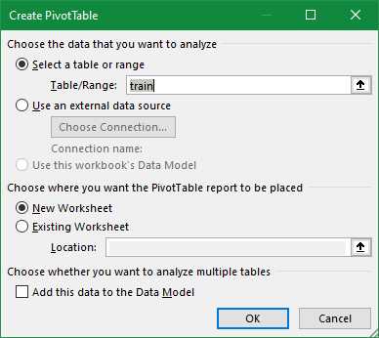

LOADED
DATASET
After transforming the date columns, the cleaned dataset is loaded into Excel for analysis. This dataset is already clean, so no additional data cleaning steps are required for this analysis.
The dataset is now fully prepared for further exploration to uncover patterns and trends. It will be analyzed using Pivot Tables to create interactive summaries based on different dimensions such as sales trends, product categories, regions, and customer segments.

Slide 6
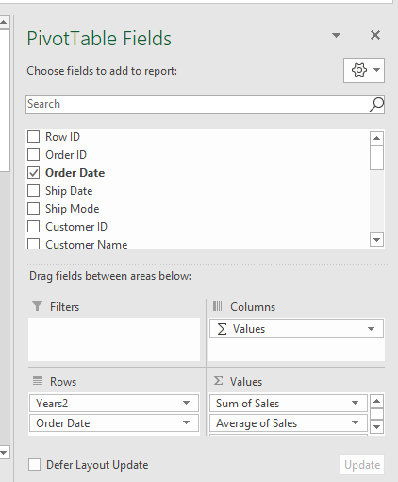
PIVOT TABLE
FOR SALES ANALYSIS
Create Pivot Table
A new Pivot Table is created in a separate sheet to analyze the sales data effectively.
Drag Fields into Pivot Table
The “Order Date” field is dragged to the Rows area to organize the data by date.
The “Sales” field is dragged to the Values area to summarize the sales data.
Multiple summary calculations are added to the sales data
Sum: Total sales for each year.
Average: Average sales per year.
Max: Maximum sales on any given year.
Min: Minimum sales on any given year.

Slide 7

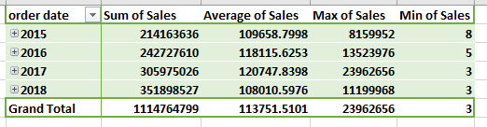
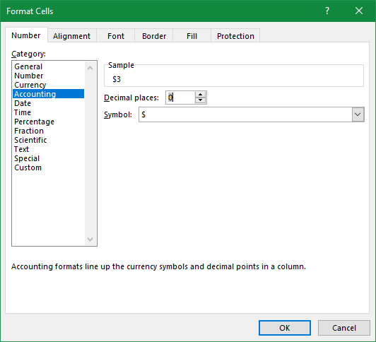
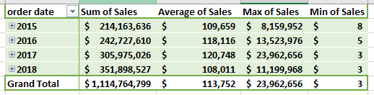
FORMATTING
PIVOT TABLE
Change Cell Format to Accounting
After creating the Pivot Table, the format of the sales values is changed to accounting for better readability and to show currency symbols.
Select the cells containing the sales data in the Pivot Table. Right click and choose Format Cells. In the Number tab, select Accounting from the list of formats. This ensures that the values are displayed with currency symbols and proper decimal places.
The sales data is now formatted to show currency values, making it easier to interpret financial figures in
the analysis.

Slide 8

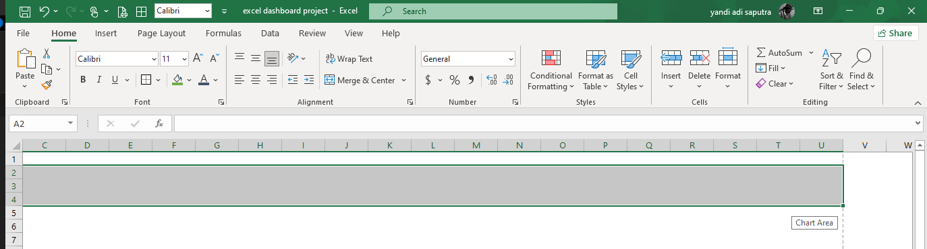
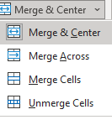
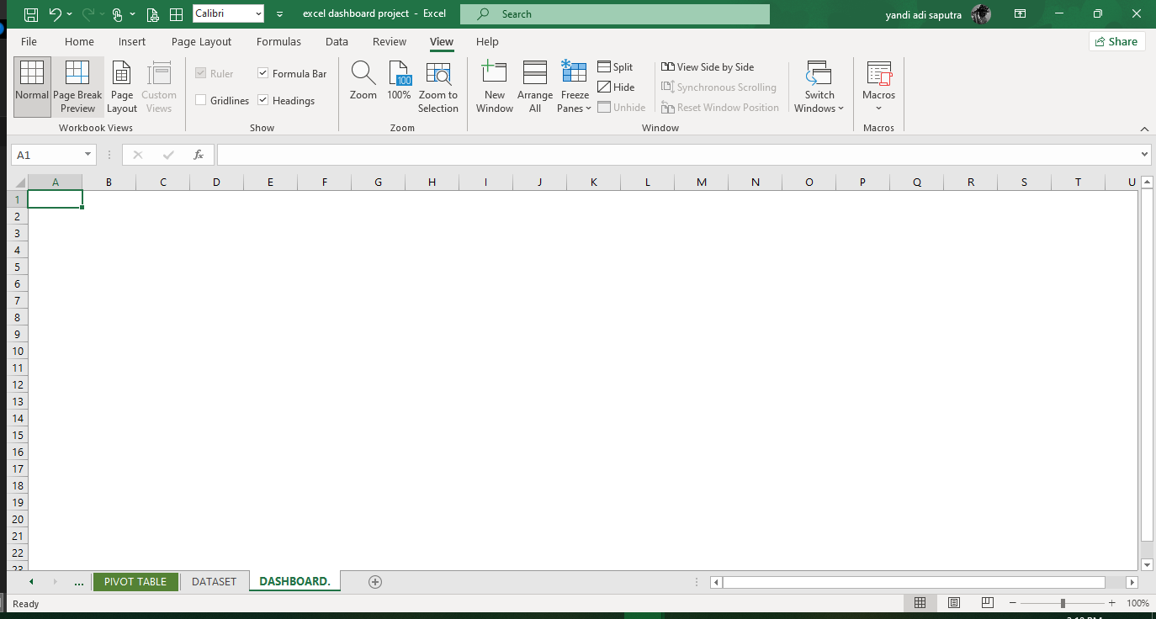
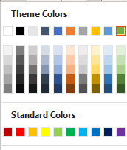
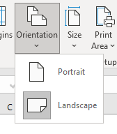
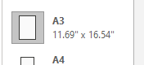
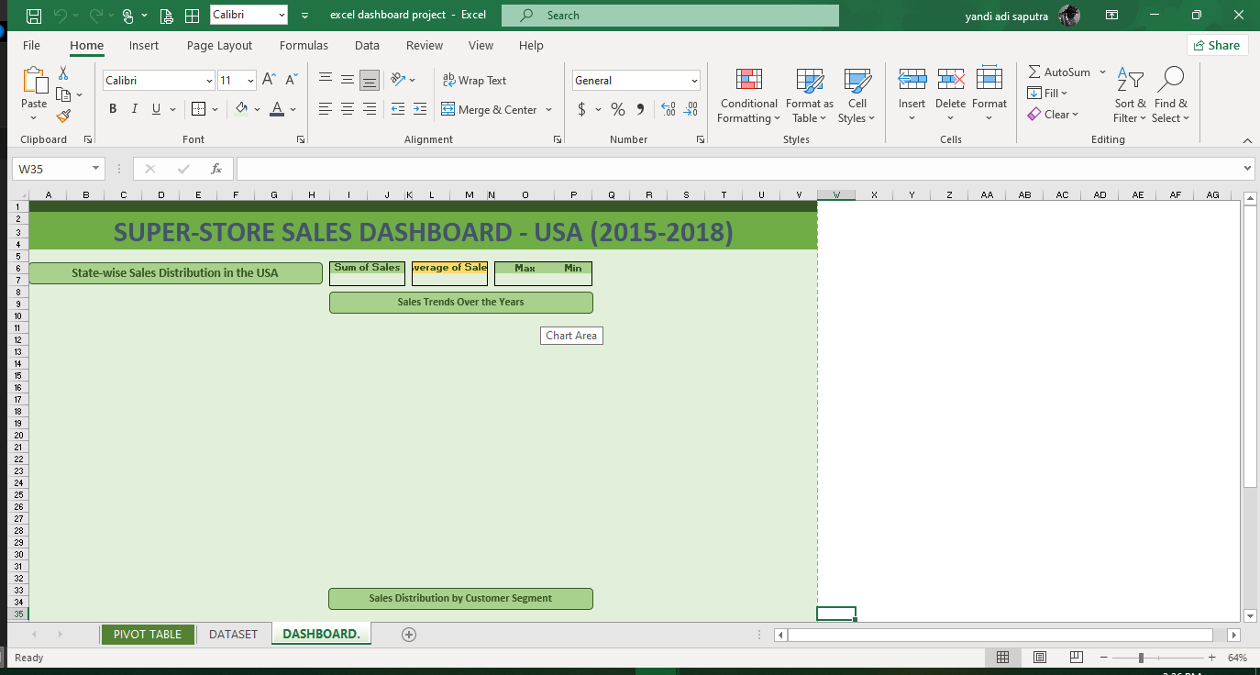
PREPARING DASHBOARD
Add Dashboard Title
Merge cells C2:U4 to create a large title area.
Apply a background color to the merged cells to highlight the title area.
Add a descriptive title text in the merged cells, and set the alignment to Center to ensure the title is positioned properly.
Create Template for Charts
Add a shape to serve as placeholders for charts and visualizations.. This shape will help structure the layout of the dashboard. This shape also used to beauty the dashboard layout and help organize different sections visually.
Resize and position the shape to create a well structured template for charts.
Create New Worksheet for Dashboard
A new worksheet is created specifically for the dashboard design.
Prepare Worksheet Settings
Turn off Gridlines: The gridlines are remove to create a clean layout for the dashboard.
Change Page Orientation: The orientation is set to Landscape to give more horizontal space for the dashboard.
Set Page Size: The page size is adjusted to A3 (11.69” x 16.54”) for better presentation.

Slide 9
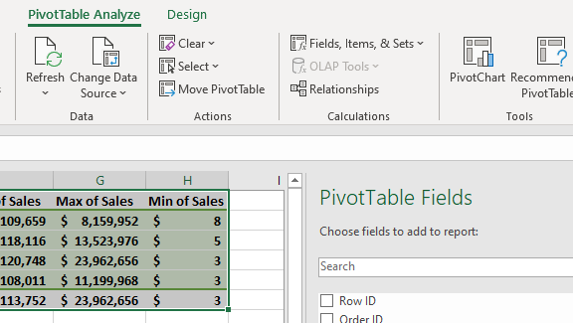
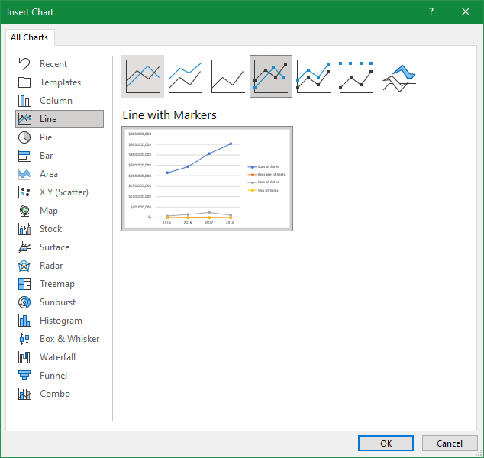
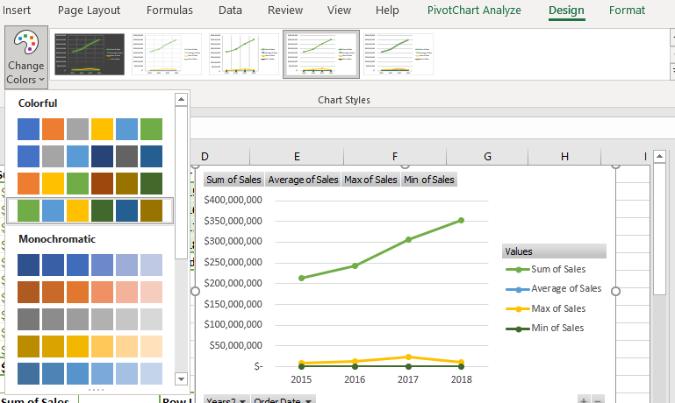
PIVOT CHART
Create Pivot Chart
A Pivot Chart is created based on the previously made Pivot Table. The chart selected is a Line Chart (Line with Markers) to visualize the sales trends over time, highlighting the changes in sales per date.
Design Adjustments
The chart’s design is customized to improve readability and visual appeal. Adjustment include changing the Colors of the line and markers to align with overall dashboard design.
Visualizing Sales Trends
The line chart now clearly shows the fluctuations in sales, making it easier to identify patters, peaks, and troughs in the sales data.

Slide 10
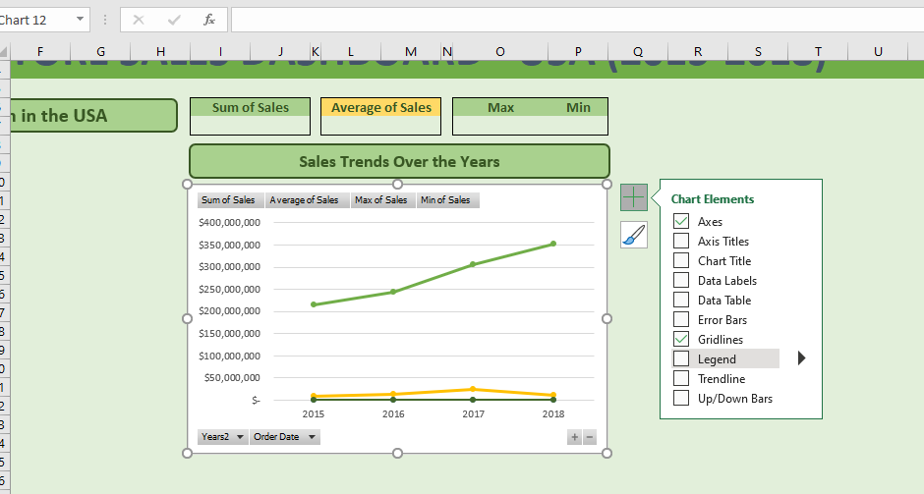
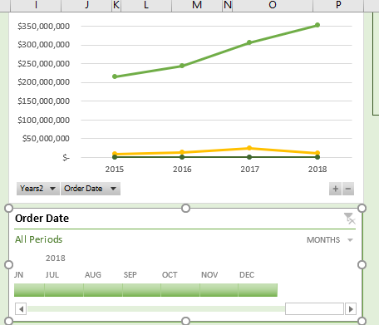
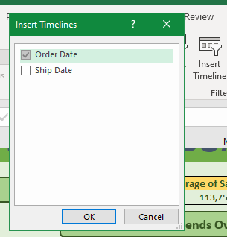
CHART PLACEMENT &
ADJUSTMENTS ON DASHBOARD
Move Pivot Chart to Dashboard
The Pivot Chart created earlier is now moved to the dashboard worksheet. This ensure that all visualizations are in one place, ready for display.
Chart Adjustment
The chart Legend is remove for a cleaner look, and chart Title is also removed to maintain a tidy and minimalistic design. These adjustment help focus on the data trends and avoid unnecessary distractions.
Insert Timeline for Order Date
A Timeline is added to allow users to filter the data by specific date ranges. This makes the dashboard interactive, enabling users to explore the sales data for different periods.

Slide 11

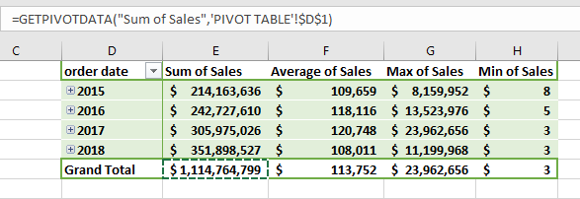
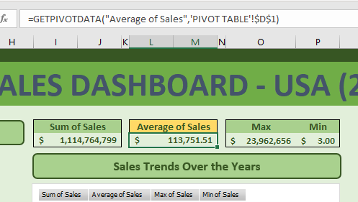
ADDING KEY METRICS
TO DASHBOARD
Key Metrics Section
A dedicated section is created on the dashboard to display important sales metrics.
Use of GETPIVOTDATA
The =GETPIVOTDATA() function is used to retrieve values directly from the Pivot Table.
Each metrics is extracted as follows:
Sum of Sales
Average of Sales
Max of Sales
Min of Sales
The retrieved values are displayed in a clean and structured layout.

Slide 12
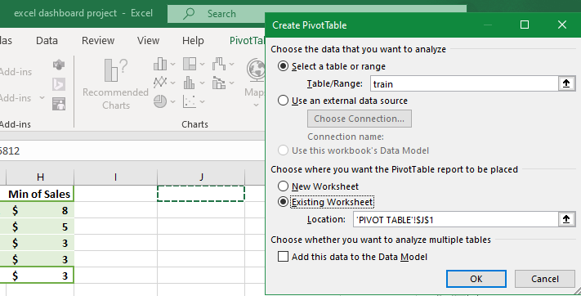
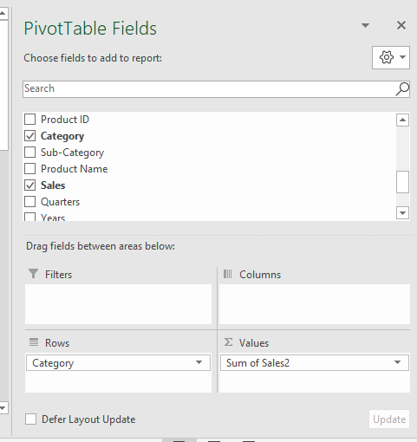
New Pivot Table
for Category
Create a New Pivot Table
A new Pivot Table is created to analyze sales data based on Category (Furniture, Office Suplies, Technology) and Sum of Sales.
During the creation, the option “Add to Existing Worksheet” is selected to place the Pivot Table in the same worksheet as the previous one. The new Pivot Table is placed in an empty area adjacent to the previous Pivot Table.
Configure Fields for the Pivot Table
Drag Category to the Rows section.
Drag Sales to the Values section, ensuring is is set to Sum.
This will be summarizes total sales by category, enabling further analysis and visualization using chart (e.g., Pie Chart).

Slide 13
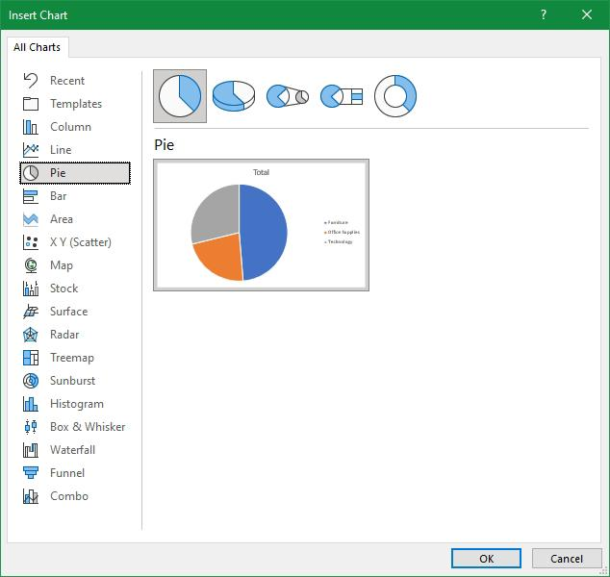
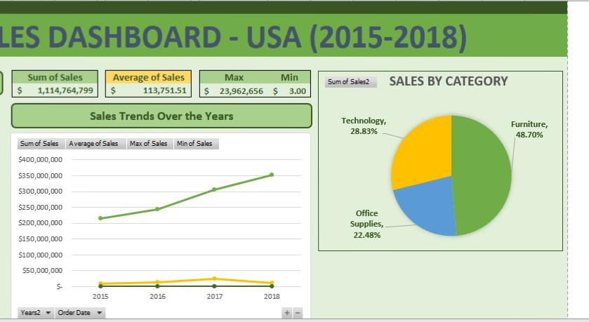
ADDING PIE CHART
TO DASHBOARD
Move Pie Chart to Dashboard The Pie Chart, created from the new Pivot Table analyzing sales by category, is moved to the dashboard worksheet. This step ensures all visualizations are consolidated in one place for better accessibility and presentation. Position the Chart The chart is placed in an appropriate section of the dashboard, ensuring it aligns well with other elements and fits into the predefined layout. Final Touches While no additional design adjustments are made at this stage, the chart is ready to visually represent the sales distribution across categories (Furniture, Office Supplies, Technology).

Slide 14
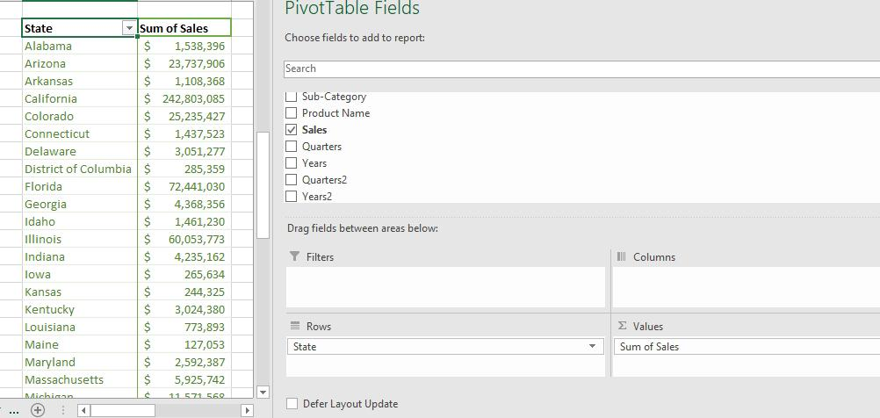
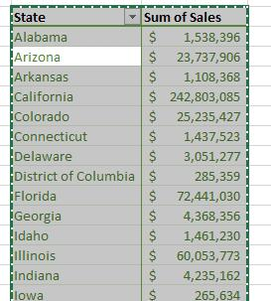
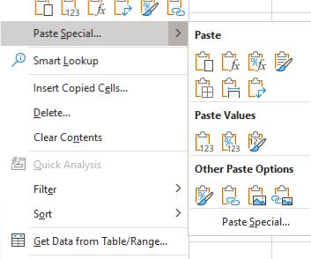
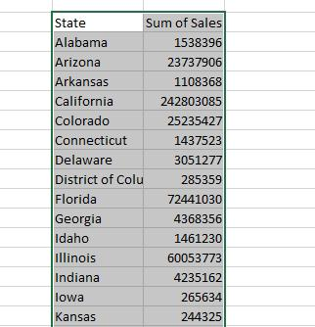
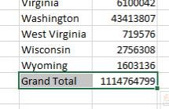
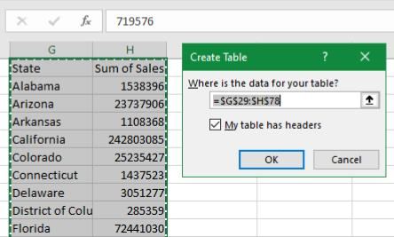
STATE WISE
WITH MAP CHART
Prepare Data for Chart
Copy and Paste as a Values to remove Pivot Table Values. This step ensures that the data format is compatible with the Map Chart creation.
Remove Grand Total, The “Grand Total” row is deleted from the pasted data to clean up the dataset. Convert to Table, The cleaned data is then converted into a regular Excel Table for better structure and ease of use.

Slide 15
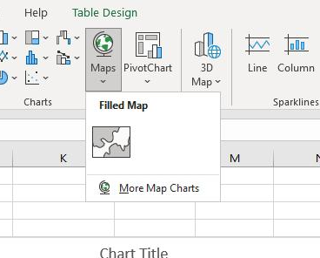
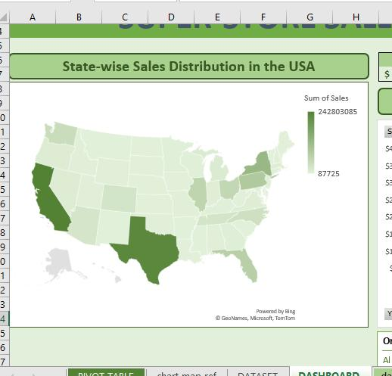
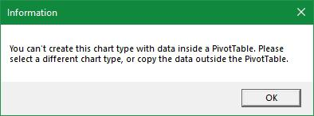
FILLED MAP CHART
& MOVE IT TO DASHBOARD
Select the pasted data, go to the Insert tab, and choose Filled Map Chart from the Charts group. Once the chart is created, move it to your dashboard by cutting and pasting it into the desired location. This avoids the error message about incompatible data from PivotTables.
Information like this will appear if the Map Chart is created directly from PivotTable data because the format is dynamic. You must copy the data and paste it as (static) values outside the PivotTable before creating the chart..

Slide 16
FINAL DASHBOARD
OVERVIEW
The dashboard presented in this slide is the final result of the analysis conducted.
It compiles insights from multiple Pivot Tables and visualizations, such as:
Sales Trends Over Time (Line Chart with Timeline).
Sales by Category (Pie Chart).
Geographical Sales Distribution (Map Chart).
Key Metrics: Sum, Average, Maximum, and Minimum Sales.
The process of creating Pivot Tables and Charts has already been thoroughly explained. By moving directly to the final overview, the audience can see the big picture of the analysis.

Slide 17

THANK
YOU

Slide 18







YANDI ADI SAPUTRA
CONTACT
Yandi Adi Saputra
yandiadisaputra11@gmail.com
+62851-8288-0966
Pedes, Karawang, Jawa Barat

